Slide 1

M365 Power Platform Services
Insert Power Platform
Insert 1/28/2025
Notes:
Title Slide should include a brief title, subtitle, and presenter information. There is placeholder copy set to the IRS design standards. To update the content simply click on the text or within a box and start typing or right click to paste copy from another source. If there is an area you do not wish to print, either leave the placeholder copy or click within the box and hit the space bar to remove it.
The Product ID line in the footer of the title slide can be deleted if not needed.

Slide 2
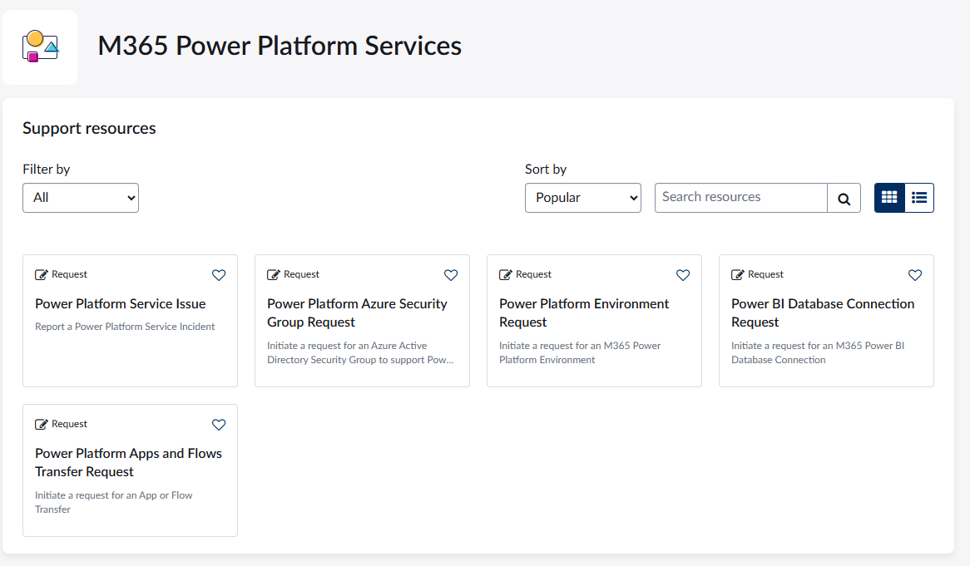
M365 Power Platform Services Offerings
M365 Power Platform Services - Employee Center

Slide 3
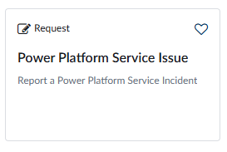
M365 Power Platform Services
For any issues or problems encountered in your Power Platform environment you can use our self-service "Power Platform Service Issue" Power Platform Service Issue - Employee Center Any code related errors and network speed issues are not covered under this option. For those, please open a general IT request from IRWorks for network latency. For example: Open this request for updating DB service account credentials, new premium connector request, app not opening, M365 issues with PowerPlatform availability, etc.

Slide 4
M365 Power Platform Services

